Slide 1
Occupational Lung Diseases
Dr. Arash Dadvand
Occupational Medicine Specialist

Slide 2
The respiratory tract is often the site of injury from occupational exposures.
Acute responses include rhino-sinusitis, laryngitis, upper airway obstruction, bronchitis, bronchoconstriction, alveolitis, and pulmonary edema.
Chronic responses include asthma, bronchitis, bronchiolitis, parenchymal fibrosis, pleural fibrosis, and cancer.
Early recognition and appropriate treatment of occupational lung diseases by physicians can reduce both morbidity and mortality significantly and greatly affect patient outcome.

Slide 3
EVALUATION OF PATIENTS WITH
OCCUPATIONAL LUNG DISEASE
The following four approaches are recommended:
(1) detailed history, including occupational and environmental exposures,
(2) thorough physical examination,
(3) appropriate imaging studies, and
(4) pulmonary function testing.

Slide 4
OCCUPATIONAL ASTHMA
Patients complain of dyspnea, wheezing, and/or cough that correlate with workplace exposures.
Patients often report feeling better in the evenings or during weekends and vacations.
Symptoms may occur 4-8 hours after exposure to the offending antigen. This may occur after the patient has left work or even at night
The suspected diagnosis should be confirmed with changes in lung function (spirometry or peak flow).

Slide 5
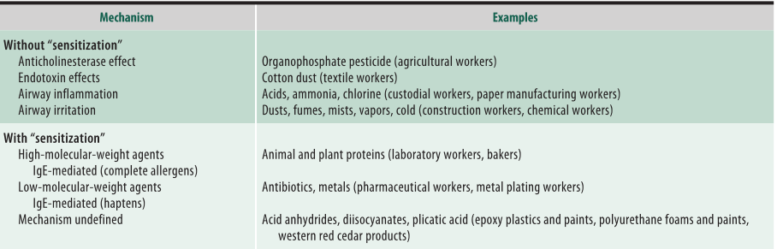
Some agents causing occupational asthma

Slide 6
HYPERSENSITIVITY PNEUMONITIS
A link between symptoms and antigen exposure may be obtained from the work or environmental history.
The antigen can be a microbial agent, animal protein, or chemical sensitizer.
The clinical presentation can be acute, subacute, or chronic {insidious onset).

Slide 7
HYPERSENSITIVITY PNEUMONITIS
Hypersensitivity pneumonitis, also known as extrinsic allergic alveolitis, refers to an immunologically mediated inflammatory disease of the lung parenchyma that is induced by inhalation of organic dusts that contain a variety of etiologic agents (eg, bacteria, fungi, amebae, animal proteins, and several low-molecular-weight chemicals).

Slide 8
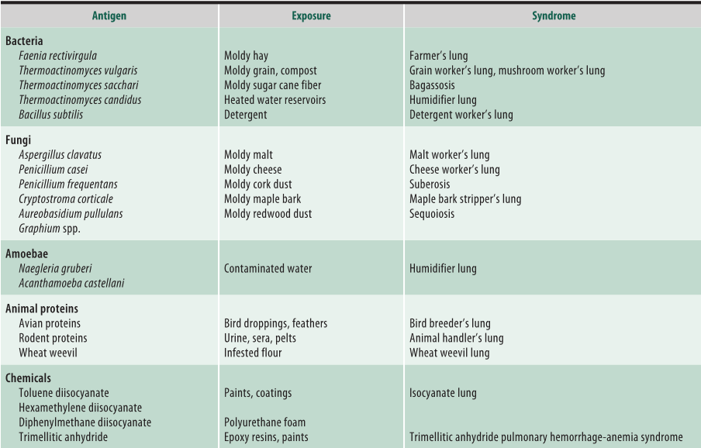
Some agents causing hypersensitivity pneumonitis

Slide 9
INHALATION FEVERS
Inhalational exposure to organic dusts, polymer fumes, and certain metals can cause a flu-like illness.
The illness is usually self-limited.
Bilateral infiltrates on chest x-ray are usually present.

Slide 10
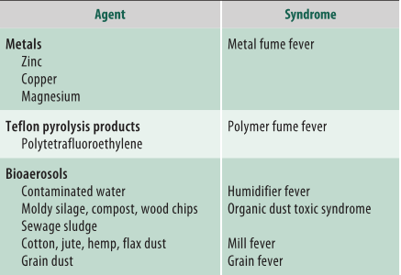
Some agents causing inhalation fever

Slide 11
PNEUMOCONIOSES
Chronic exposure, usually over years, to mineral dusts can cause fibrotic ILD.
Symptoms are typically progressive dyspnea and dry cough.
Diagnosis is usually made on the basis of radiographic abnormalities, which may precede lung function impairment.

Slide 12
PNEUMOCONIOSES
The pneumoconioses are a group of conditions resulting from the deposition of mineral dust in the lung and the sub-sequent ftbrotic lung tissue reaction to the dust.
The diagnosis will usually made based on chest imaging.
Radiographically evident interstitial opacitie1 may appear before impairment of pulmonary function or asymptoms.
The risk of disease is clearly associated with level of exposure. Chronic exposure (i.e. years) will required for most typically of pneumoconioses. Typically, a long latent period (>5 years)
between onset of exposure and clinical manifestation of disease is also required.

Slide 13
Silicosis
Exposure to silica can lead to one of three disease patterns:
(1) chronic simple silicosis, which usually follow more than 10 years of exposure to respirable dust with less than 30% quartz.
(2) subacute/accelerated silicosis, which generally follows shorter, heavier exposures (ie, 2-5 years).
(3) acute silicosis, which is seen often following intense exposure to fine dust of high silica content over a several-month period.

Slide 14
Asbestosis
Asbestosis refer to the diffuse interstitial pulmonary fibrosis caused by inhalation of asbestos fibers.
latency period (usually at least 20 years) between onset of exposure and development of clinically apparent disease.
Major occupational exposures occurred with asbestos mining and milling. manufacture of friction materials for brake linings, textile manufacture,……

Slide 15
Coal Workers' Pneumoconiosis
Coal workers' pneumoconiosis is the term used to describe parenchymal lung disease caused by the inhalation of coal dust.
The condition is seen rarely in those who have spent fewer than 20 years underground.
The coal macule is the primary lesion in coal workers' pneumoconiosis.
The symptoms of cough and sputum production are common among coal miners and often are the result of chronic bronchitis from dust inhalation rather than coal workers' pneumoconiosis.

Slide 16
Thank you

