Slide 1
Toxicology for pharmacists

Slide 2
Tricyclic antidepressants
Serotonin reuptake inhibitors
Natural products

Slide 3
Tricyclic antidepressants (TCA)
Mechanism of toxicity.
Cardiovascular effects. Several mechanisms contribute to cardiovascular toxicity:
Anticholinergic effects and inhibition of neuronal reuptake of catecholamines result in tachycardia and mild hypertension.
Peripheral alpha-adrenergic blockade causes vasodilation and contributes to hypotension.
Membrane-depressant (quinidine-like) effects cause myocardial depression and cardiac conduction disturbances by inhibition of the fast sodium channel that initiates the cardiac cell action potential.
Metabolic or respiratory acidosis may contribute to cardiotoxicity by further inhibiting the fast sodium channel

Slide 4
Central nervous system effects.
These effects result in part from anticholinergic toxicity (eg, sedation and coma), but seizures are probably a result of inhibition of reuptake of norepinephrine or serotonin in the brain or other central effects.

Slide 5
Pharmacokinetics.
Anticholinergic effects of these drugs may retard gastric emptying, resulting in slow or erratic absorption.
Most of these drugs are extensively bound to body tissues and plasma proteins, resulting in very large volumes of distribution and long elimination half-lives.
Tricyclic antidepressants are metabolized primarily by the liver, with only a small fraction excreted unchanged in the urine.
Active metabolites may contribute to toxicity; several drugs are metabolized to other well known tricyclic antidepressants (eg, amitriptyline to nortriptyline, imipramine to desipramine)

Slide 6
Toxic dose.
Most of the tricyclic antidepressants have a narrow therapeutic index, so that doses of less than 10 times the therapeutic daily dose may produce severe intoxication.
In general, ingestion of 10–20 mg/kg is potentially life-threatening.

Slide 7
Clinical presentation.
Tricyclic antidepressant poisoning may produce any of three major toxic syndromes: anticholinergic effects, cardiovascular effects, and seizures.
Hyponatremia is also common.
Depending on the dose and the drug, patients may experience some or all of these toxic effects.
Symptoms usually begin within 30–40 minutes of ingestion but may be delayed owing to slow and erratic gut absorption.
Patients who are awake initially may abruptly lose consciousness or develop seizures without warning

Slide 8
Anticholinergic effects include sedation, delirium, coma, dilated pupils, dry skin and mucous membranes, diminished sweating, tachycardia, diminished or absent bowel sounds, and urinary retention.
Myoclonic muscle jerking is common with anticholinergic intoxication and may be mistaken for seizure activity.

Slide 9
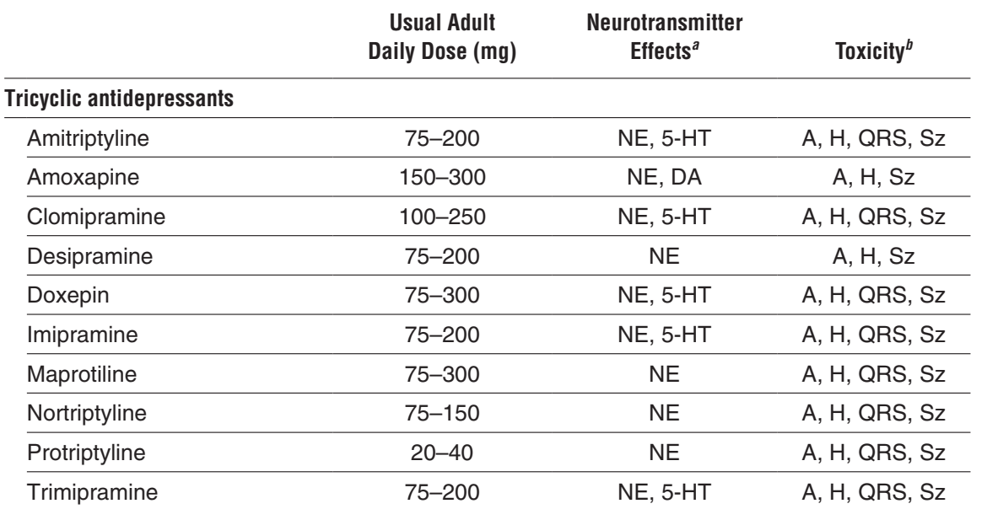

Slide 10
Cardiovascular toxicity
Manifests as abnormal cardiac conduction, arrhythmias, and hypotension.
Typical electrocardiographic findings include sinus tachycardia with prolongation of the PR, QRS, and QT intervals. A prominent terminal R wave is often seen in lead aVR.
Various degrees of atrioventricular (AV) block may be seen. A Brugada pattern (down-sloping ST-segment elevation in V1–V3 in association with a right bundle branch block) has also been reported.
a. Prolongation of the QRS complex to 0.12 seconds or longer, a terminal R wave of 3 mm or more in aVR, and a terminal R wave/S wave ratio of 0.7 or more in aVR are fairly reliable predictors of serious cardiovascular and neurologic toxicity (except in the case of amoxapine, which causes seizures and coma with no change in the QRS interval).

Slide 11
Cardiovascular toxicity
b. Sinus tachycardia accompanied by QRS-interval prolongation may resemble ventricular tachycardia. True ventricular tachycardia and fibrillation may also occur.
c. Atypical or polymorphous ventricular tachycardia (torsade de pointes) associated with QT-interval prolongation may occur with therapeutic dosing but is actually uncommon in overdose.
d. Development of bradyarrhythmias usually indicates a severely poisoned heart and carries a poor prognosis

Slide 12
Hypotension caused by venodilation is common and usually mild. In severe cases, hypotension results from myocardial depression and may be refractory to treatment; some patients die with progressive, intractable cardiogenic shock.
Pulmonary edema is also common in severe poisonings.

Slide 13
Seizures are common with tricyclic antidepressant toxicity and may be recurrent or persistent. The muscular hyperactivity from seizures and myoclonic jerking, combined with diminished sweating, can lead to severe hyperthermia, resulting in rhabdomyolysis, brain damage, multisystem failure, and death.

Slide 14
Death
Death from tricyclic antidepressant overdose usually occurs within a few hours of admission and may result from ventricular fibrillation, intractable cardiogenic shock, or status epilepticus with hyperthermia.
Sudden death several days after apparent recovery has been reported occasionally, but in all such cases, there was evidence of continuing cardiac toxicity within 24 hours of death.

Slide 15
Diagnosis.
Specific levels
Other useful laboratory studies include electrolytes, glucose, BUN, creatinine, creatine kinase (CK), urinalysis for myoglobin, arterial blood gases or oximetry, 12-lead ECG and continuous ECG monitoring, and chest radiography.

Slide 16
A. Emergency and supportive measures
Maintain an open airway and assist ventilation if necessary Caution: Respiratory arrest can occur abruptly and without warning.
Treat coma, seizure, hyperthermia, hypotension, and arrhythmias if they occur.
Note: Do not use procainamide or other type Ia or Ic antiarrhythmic agents for ventricular tachycardia because these drugs may aggravate cardiotoxicity.

Slide 17
Cardiac Pacing
Seizure control

Slide 18
In patients with QRS-interval prolongation or hypotension, administer sodium bicarbonate (p 520), 1–2 mEq/kg IV, and repeat as needed to maintain arterial pH between 7.45 and 7.55.
Sodium bicarbonate may reverse membrane-depressant effects by increasing extracellular sodium concentrations and by a direct effect of pH on the fast sodium channel.
Hypertonic sodium chloride has similar effects in animal studies and some human case reports.

Slide 19
When cardiotoxicity persists despite treatment with sodium bicarbonate, the use of lidocaine can be considered, although evidence in people is still limited.
Lidocaine competes with tricyclic antidepressants for binding at the sodium channel but binds for a shorter period of time and thus may reverse some of sodium channel blockade.

Slide 20
For severe tricyclic overdose, particularly with amitriptyline and clomipramine, the use of intravenous lipid emulsion therapy has been reported to be beneficial

Slide 21
Non-cyclic antidepressants
SSRIs inhibit serotonin reuptake transporters resulting in increased stimulation of serotonin receptors in the brain.
SNRIs inhibit both serotonin and norepinephrine reuptake transporters and also increase stimulation of CNS norepinephrine receptors.
Most agents cause CNS depression.
Bupropion is a stimulant that can also cause seizures, presumably related to inhibition of reuptake of dopamine and norepinephrine.

Slide 22
Trazodone and mirtazapine produce peripheral alpha-adrenergic blockade, which can result in hypotension and priapism
Serotonin reuptake inhibitors, such as fluoxetine, citalopram, sertraline, paroxetine, fluvoxamine, venlafaxine, and trazodone, may interact with each other, with chronic use of an MAO inhibitor, or with dextromethorphan to produce the “serotonin syndrome”

Slide 23
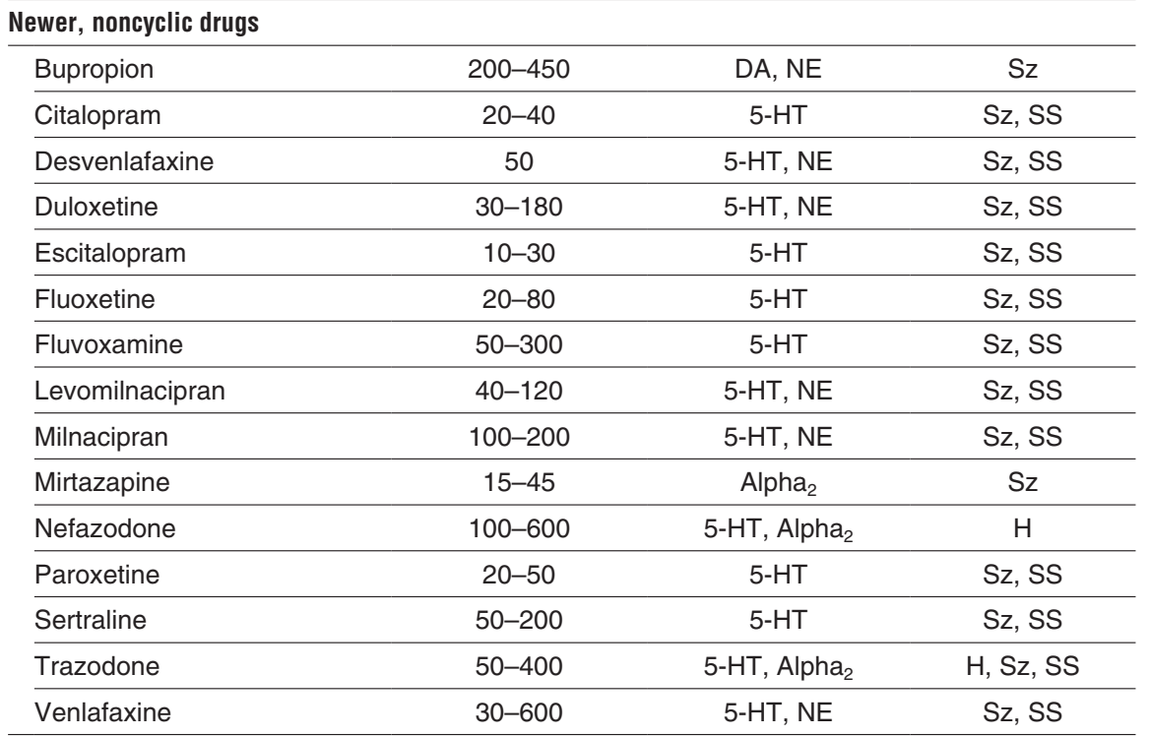

Slide 24
Central nervous system
The usual presentation after SSRI overdose includes ataxia, sedation, and coma.
Respiratory depression may occur, especially with co-ingestion of alcohol or other drugs.
These agents, particularly bupropion, can cause restlessness, anxiety, and agitation.
Tremor and seizures are common with bupropion but occur occasionally after overdose with SSRIs, particularly citalopram, as well as the SNRIs venlafaxine and duloxetine.

Slide 25
Cardiovascular
Cardiovascular effects are usually not life-threatening, although trazodone can cause hypotension and orthostatic hypotension, bupropion and SNRIs can cause sinus tachycardia and hypertension, and citalopram and escitalopram can cause sinus bradycardia with hypotension.
1. Severe cardiotoxicity, including QRS-interval prolongation, hypotension, and cardiac arrest, has been reported with overdoses involving bupropion, citalopram, and venlafaxine.
2. Venlafaxine and citalopram also cause QT-interval prolongation, and the FDA has recommended a maximal daily citalopram dose of 40 mg to minimize the risk of torsade de pointes.

Slide 26
Serotonin syndrome
Neuromuscular hyperactivity (hyperreflexia, spontaneous or induced clonus, ocular clonus, rigidity, shivering); autonomic instability (tachycardia, hypertension, diaphoresis, hyperthermia, mydriasis, tremor); and mental status changes (agitation, anxiety, confusion, hypomania).
This reaction may be seen when a patient taking an MAO inhibitor ingests a serotonin uptake blocker. Because of the long duration of effect of MAO inhibitors and most of the serotonin uptake blockers, this reaction can occur up to several days to weeks after either treatment regimen has been discontinued.

Slide 27
Serotonin syndrome
The syndrome has also been described in patients taking an overdose of a single SSRI or SNRI, an SSRI with meperidine, fentanyl, amphetamines, and derivatives(e.g., methylenedioxymethamphetamine [MDMA]), dextromethorphan, linezolid, lithium, St. John’s wort or combinations of various SSRIs and/or SNRIs.

Slide 28
Diagnosis
Levels
Lab studies
Clinical signs

Slide 29
Treatment
Supportive
Serotonin syndrome
Seizure

Slide 30
COLCHICINE
Mechanism of toxicity. Colchicine inhibits microtubular formation and function, arresting dividing cells during mitosis. Pharmacokinetics: Colchicine is rapidly absorbed after oral administration and extensively distributed to body tissues.
It is eliminated in the liver by CYP3A4 with a half-life of 4.4–31 hours

Slide 31
Toxic dose. The maximum FDA-approved therapeutic dose of oral colchicine for acute gout is 1.2 mg followed by 0.6 mg after 1 hour, for a total dose of 1.8 mg.
This is a significant reduction from the previously recommended maximum dose of 8 mg. In a series of 150 cases, doses of 0.5 mg/kg or less were associated with diarrhea and vomiting but not death, doses of 0.5–0.8 mg/kg were associated with bone marrow aplasia and 10% mortality, and ingestions greater than 0.8 mg/kg uniformly resulted in death.

Slide 32
Fatalities, however, have been reported with single ingestions of as little as 7 mg, although other case reports describe survival after ingestions of more than 60 mg.
Ingestions of parts of colchicine containing plants have resulted in severe toxicity and death.
The dose used for familial Mediterranean fever in adults is slightly higher at 1.2–2.4 mg per day.
Dosing should be reduced for renal dysfunction for all uses of colchicine.

Slide 33
Clinical presentation. Colchicine poisoning affects many organ systems, with toxic effects occurring from hours to several days after exposure.
A. After an acute overdose, symptoms typically are delayed for 2–12 hours and include nausea, vomiting, abdominal pain, and severe bloody diarrhea.
Shock results from depressed cardiac contractility and fluid loss into the GI tract and other tissues. Delirium, seizures, or coma may occur.
Lactic acidosis related to shock and inhibition of cellular metabolism is common.
Other manifestations of colchicine poisoning include acute myocardial injury, rhabdomyolysis with myoglobinuria, disseminated intravascular coagulation, and acute renal failure.

Slide 34
Chronic colchicine poisoning presents with a more insidious onset. Factors precipitating toxicity from chronic use include renal insufficiency, liver disease, and drug interactions (erythromycin, cimetidine, cyclosporine) that can inhibit colchicine clearance.
B. Death usually occurs after 8–36 hours and is caused by respiratory failure, intractable shock, and cardiac arrhythmias or sudden cardiac arrest.
C. Late complications include bone marrow suppression, particularly leukopenia and thrombocytopenia (4–5 days) and alopecia (2–3 weeks). Chronic colchicine therapy may produce myopathy (proximal muscle weakness and elevated creatine kinase [CK] levels) and polyneuropathy. This also has occurred after acute poisoning

Slide 36
DIGOXIN AND OTHER CARDIAC GLYCOSIDES
A. With acute overdose, nausea, vomiting, hyperkalemia, and cardiac arrhythmias are often seen. Bradyarrhythmias include sinus bradycardia, sinoatrial arrest, second- or third-degree AV block, and asystole. Tachyarrhythmias include paroxysmal atrial tachycardia with AV block, accelerated junctional tachycardia, ventricular bigeminy, ventricular tachycardia, bidirectional ventricular tachycardia, and ventricular fibrillation.
B. With chronic intoxication, nausea, anorexia, abdominal pain, visual disturbances (flashing lights, halos, green-yellow perceptual impairment), weakness, fatigue, sinus bradycardia, atrial fibrillation with slowed ventricular response

Slide 37
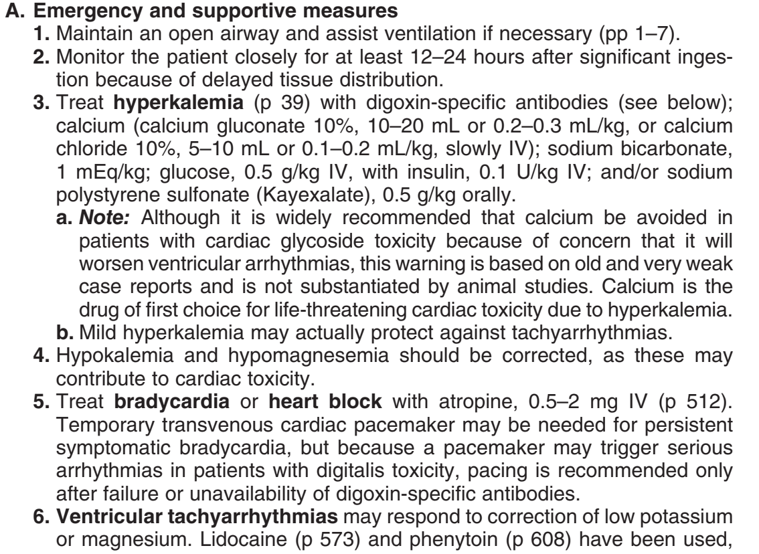

Slide 39
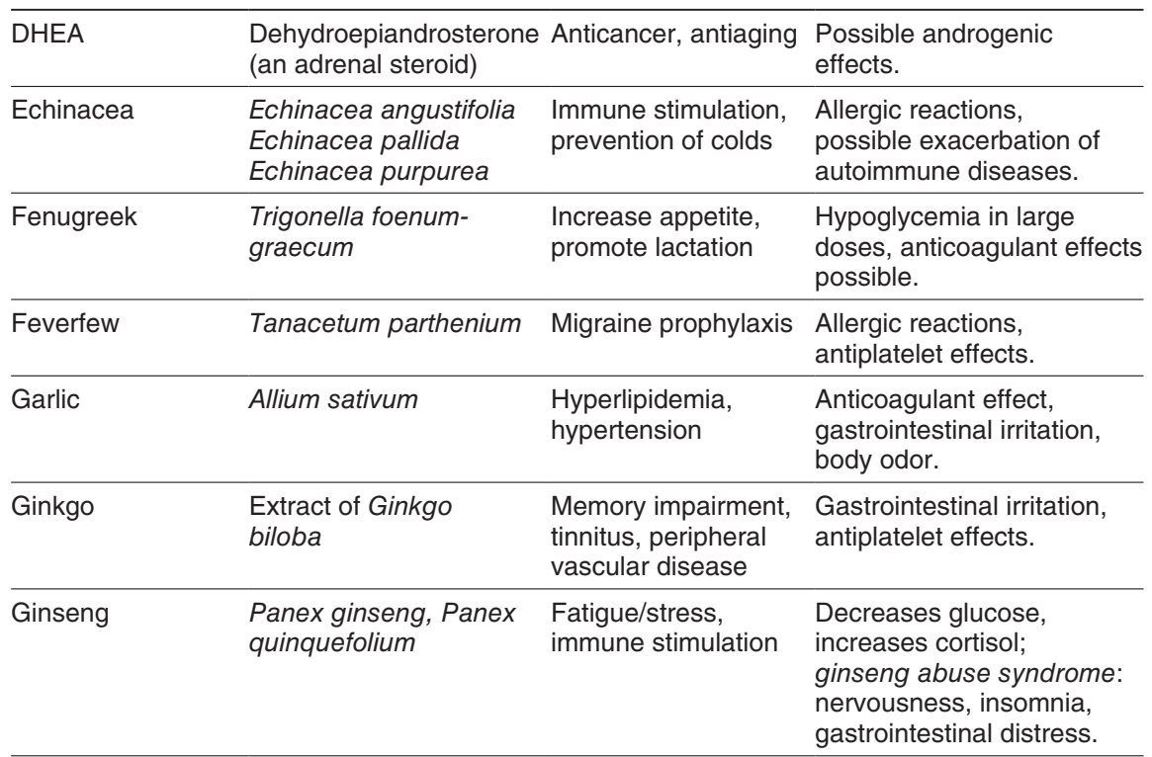

Slide 40
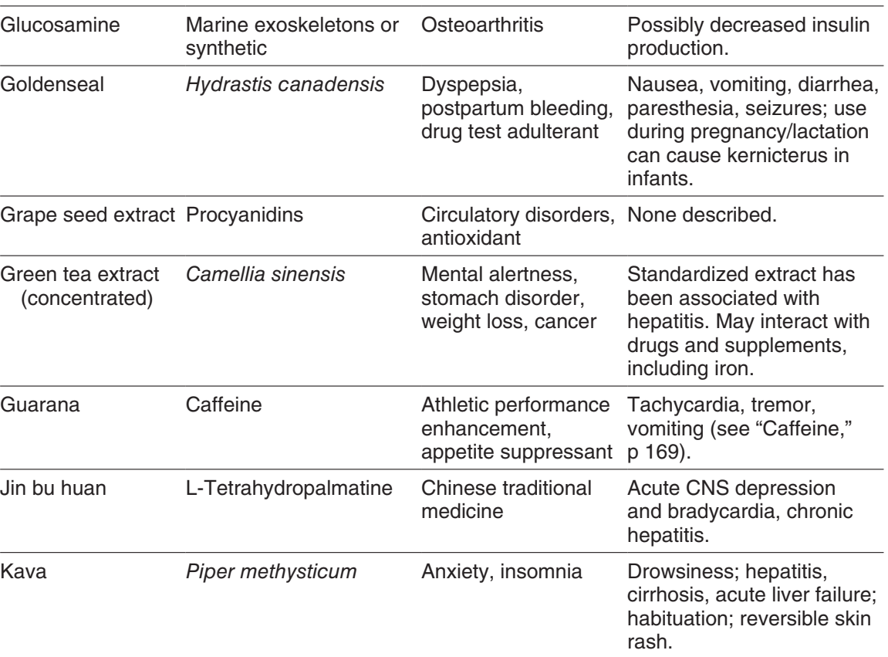

Slide 41
