Slide 1
به نام خدا

Slide 2
GOALS OF ASTHMA TREATMENT
Reduce impairment
Reduce risk

Slide 3
Reduce impairment — Impairment refers to the intensity and frequency of asthma symptoms and the degree to which the patient is limited by these symptoms. Specific goals for reducing impairment include: Freedom from frequent or troublesome symptoms of asthma (cough, chest tightness, wheezing, or shortness of breath), including symptoms that disturb sleep Minimal need (≤2 times per week) of inhaled short acting beta agonists (SABAs) to relieve symptoms Optimization of lung function Maintenance of normal daily activities, including work or school attendance and participation in athletics and exercise Satisfaction with asthma care on the part of patients and families

Slide 4
Reduce risk — the Specific goals for reducing risk include: Prevention of recurrent exacerbations and need for emergency department or hospital care Prevention of reduced lung growth in children, and loss of lung function in adults Optimization of pharmacotherapy with minimal or no adverse effects

Slide 5
CONTROLLING TRIGGERS AND CONTRIBUTING CONDITIONS
Inhaled allergens
Respiratory irritants
Comorbid conditions
Medications
Complications of influenza
Complications of pneumococcal infection
Dietary sulfites

Slide 6
Categories of asthma severity
Reported symptoms over the previous two to four weeks
Current level of lung function (FEV ₁ and FEV ₁ /FVC values)
Number of exacerbations requiring oral glucocorticoids per year

Slide 7
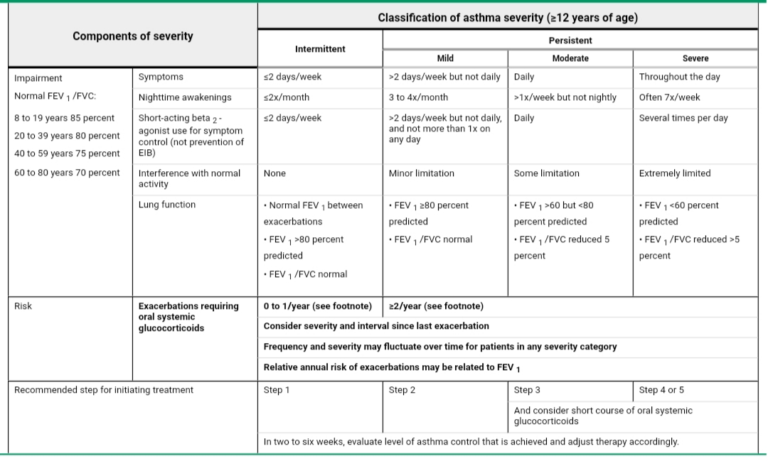

Slide 8
Intermittent (Step 1)
Patients with mild intermittent asthma are best treated with a quick-acting inhaled beta-2-selective adrenergic agonist, taken as needed for relief of symptoms

Slide 9
Mild persistent (Step 2)
For mild persistent asthma, the preferred long-term controller is a low dose inhaled glucocorticoid (GC)
Alternative strategies for treatment of mild persistent asthma include leukotriene receptor antagonists, theophylline , and cromoglycates

Slide 10
Moderate persistent (Step 3)
For moderate persistent asthma, the preferred therapies are either low-doses of an inhaled glucocorticoid plus a long-acting inhaled beta agonist, or medium doses of an inhaled glucocorticoid

Slide 11
Severe persistent (Step 4 or 5)
For severe persistent asthma, the preferred treatments are medium (Step 4) or high (Step 5) doses of an inhaled glucocorticoid, in combination with a long-acting inhaled beta-agonist .
In addition, for patients who are inadequately controlled on high-dose inhaled GCs and LABAs, the anti-IgE therapy omalizumab may be considered if there is objective evidence (allergy skin tests or in vitro measurements of allergen-specific IgE) of sensitivity to a perennial allergen and if the serum IgE level is within the established target range

Slide 12
Step 6 therapy for the management of severe asthma involves the addition of oral glucocorticoids on a daily or alternate-day basis.

Slide 13
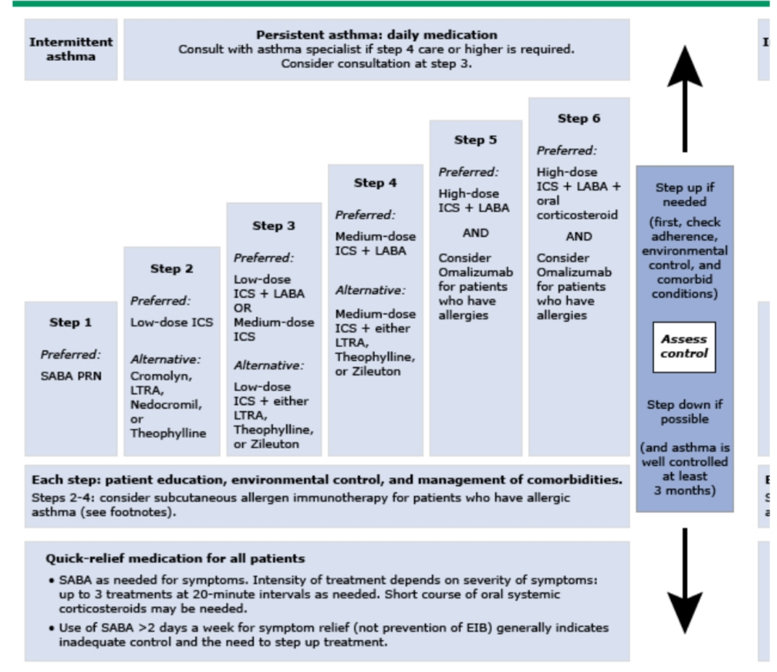

Slide 14
WHEN TO REFER — Both pulmonologists and allergists/immunologists have specialty training in asthma care. Referral for consultation or comanagement is recommended when any of the following circumstances arise: The patient has experienced a life-threatening asthma exacerbation The patient has required hospitalization or more than two bursts of oral corticosteroids in a year The adult and pediatric patient older than five years requires step 4 care or higher or a child under five requires step 3 care or higher Asthma is not controlled after three to six months of active therapy and appropriate monitoring The patient appears unresponsive to therapy The diagnosis of asthma is uncertain Other conditions are present which complicate management (nasal polyposis, chronic sinusitis, severe rhinitis, allergic bronchopulmonary aspergillosis, COPD, vocal cord dysfunction, etc) Additional diagnostic tests are needed (skin testing for allergies, bronchoscopy, complete pulmonary function tests) Patient may be a candidate for allergen immunotherapy

