Slide 1
IN THE NAME OF GOD

Slide 2
Asthma Attack

Slide 3
An asthma attack is a sudden worsening of asthma symptoms caused by the tightening of muscles around your airways. This tightening is called a bronchospasm. During the asthma attack, the lining of the airways also becomes swollen or inflamed and thicker mucus -- more than normal -- is produced.

Slide 4
All of these factors -- bronchospasm, inflammation, and mucus production -- cause symptoms of an asthma attack such as trouble breathing, wheezing, coughing, shortness of breath, and difficulty performing normal daily activities.

Slide 5
Diagnosis

Slide 6
Asthma exacerbations can be classified as mild, moderate, severe, or life threatening. Criteria for exacerbation severity are based on symptoms and physical examination parameters, as well as lung function and oxygen saturation.

Slide 7
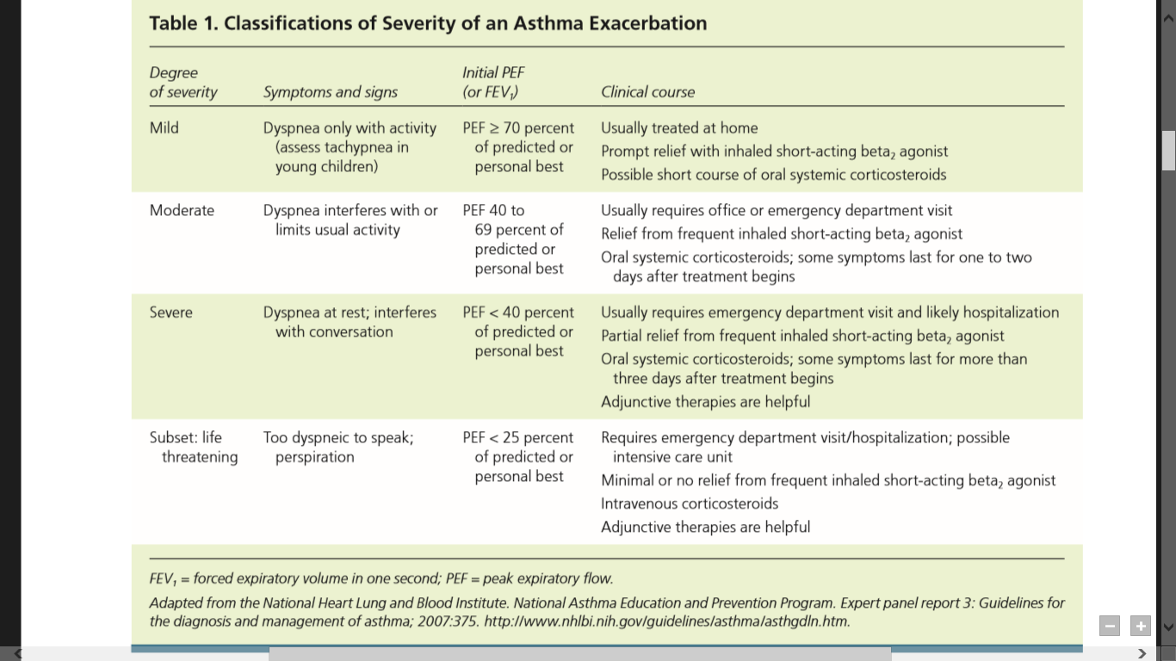

Slide 8
Although no single parameter has been identified to assess exacerbation severity,lung function is a useful method of assessment,with a PEF of 40 percent or less of predicted function indicating a severe attack in patients five years or older.

Slide 9
The most useful signs for determining the severity of an asthma exacerbation in children younger than five years,or any child unable to perform a PEF, include the use of accessory muscles of respiration, chest wall retractions,tachypnea greater than 60 breaths per minute, cyanosis,and the presence of inspiratory and expiratory wheezing.

Slide 10
For all patients, pulse oximetry on room air is a useful initial assessment.An oxygen saturation of less than 92 to 94 percent one hour after beginning standard treatment is a strong predictor of the need for hospitalization.

Slide 11
Laboratory data are not required for most patients with acute exacerbations. Chest radiography is not routinely recommended because it has not been shown to alter the care of patients with an uncomplicated asthma exacerbation.

Slide 12
Management
HOME TREATMENT
EMERGENCY DEPARTMENT TREATMENT

Slide 13
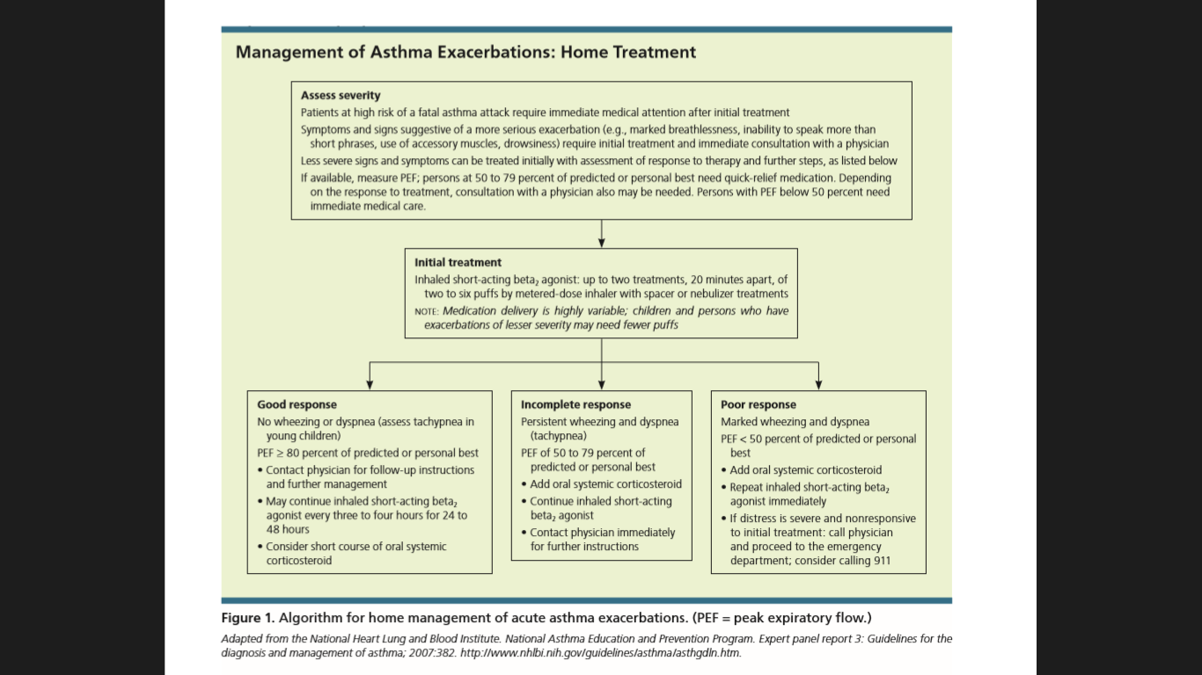

Slide 14
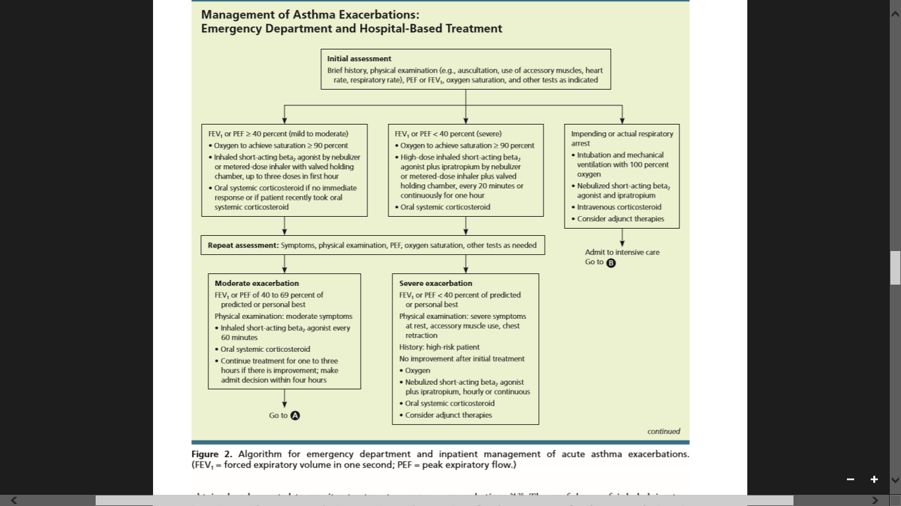

Slide 15
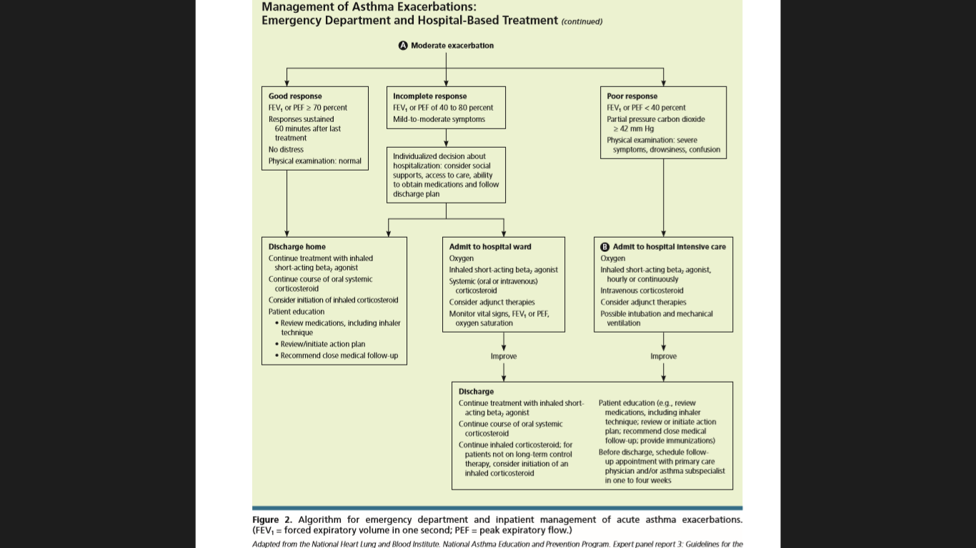

Slide 16
POSTDISCHARGE CARE

Slide 17
Patients sent home from the emergency department with systemic corticosteroids (a five-to10-day nontapering course of 50- to 100-mg prednisone per day in adults) have decreased relapse of asthma symptoms, future hospitalizations,and use of short-acting beta2 agonists.

Slide 18
Allergen avoidance is routinely recommended after emergency department discharge to decrease further acute exacerbations of asthma.

Slide 19
Regardless of the therapy chosen in the acute care setting,step-up therapy should be continued for several days to weeks after discharge. Because exacerbations vary in severity,close communication between patients and physicians is required.

Slide 20
Symptoms may be controlled quickly, but airway inflammation may persist for two to three weeks. Scheduled dosing with inhaled beta2 agonists should be continued until symptoms and PEF return to baseline.

